Slide 1
Advanced SQL Project – IMDB Dataset Analysis
Name : v.DHANASEKARAN
Course : Data analysis & data science
Batch : april 2025 & an
Date : 27/06/2025

Slide 2
Project Overview & Objectives
Overview :
The project focus on to analyze the simplified version of an IMDB database perform through the SQL queries
Objective :
To perform the SQL functions like Joins, Grouping, Filtering And Aggregate Functions.
Derive the meaningful insights from the database.
To improve the query writing and presentation skills.

Slide 3
DATASET OVERVIEW
The IMDB dataset consist of :
Movies : Title, Release Year, Duration, Country, Income, Languages, And Production Companies
Genres : The Genres Like Action, Drama, Sci-fi, Etc..
Directors MAPPING: Contains Director Id And Movie Id
Role Mapping : It Contains Info Like Actor/Actress Through The Ids
Names : It Contains Names , Height , Date Of Birth And Known For Movies
Ratings : That Contains Total Votes , Average Ratings And Median Ratings

Slide 4
Tools And Used SQL Functions
Tool Used :
MYSQL
Used SQL Functions :
Joins , Group By, Having
Aggregation Like Count, Average, Sum
Filtering With Where, Like, In And Limit
Sorting By Order by Function
Arrange Results Using Ascending And Descending Function

Slide 5
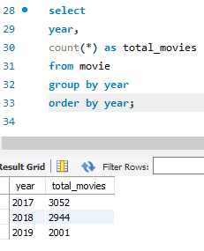
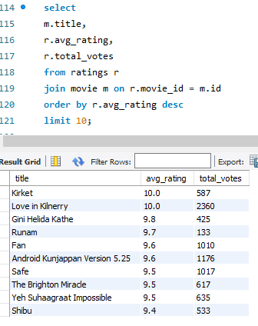
Key Questions Answered
How Many Movies Per Year ?
2017 = 3052
2018 = 2944
2019 = 2001
Top 10 Movies Based Avg Rating ?
Kirket
Love In Kilnerry
Gini Helida Kathe
Runam
Fan
Android Kunjappan Version 5.25
Safe
The Brighton Miracle
Yeh Suhaagraat Impossible
Shibu

Slide 6
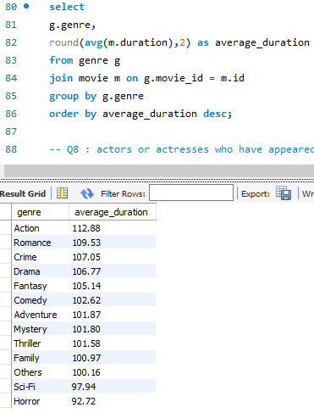
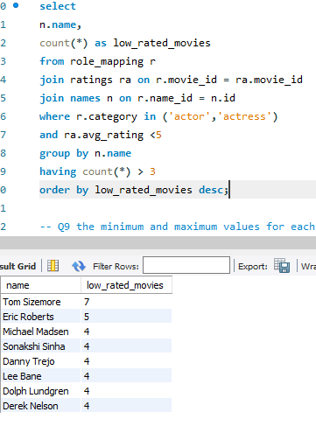
The Average Movie Duration By Genre?
Action = 112.88
Romance = 109.53
Crime = 107.05
Drama = 106.77
Fantasy = 105.14 etc ,..
The Actors/Actresses With More Than 3 Low-rated Movies (Rating < 5)?
Tom Sizemore
Eric Roberts
Michael Madsen
Sonakshi Sinha
TrejoDanny
Lee Bane
Dolph Lundgren
Derek Nelson

Slide 7
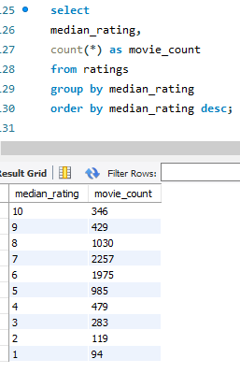
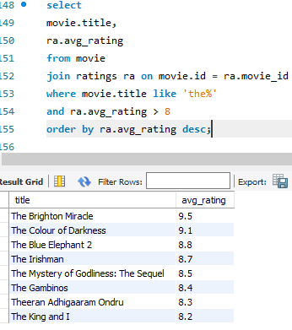
Grouping Movies Based On Their Median Ratings?
Grouping The Movies Based On The Median Ratings From The Ratings Table
Arrange The Order In Descending To Get Higher On First
Movies From Each Genre With Word “The” Avg Rating >=8?
The Brighten Miracle = 9.5
The Colour Of Darkness = 9.1
The Blure Elephant = 8.8
The Irishman = 8.7
The Mystery Of Godliness: The Squel = 8.5
The Gambinos = 8.4
Theeran Adhigaaram Ondru = 8.3
The King And I = 8.2

Slide 8
Key Insights In The IMDB Dataset
Movie insights :
In the year 2017 has a more movies were released in worldwide.
In an year January, march, September and octobar months has more movies released.
Genre insights :
Drama Genre Has Highest Number Of Movies Were Filmed.
Action Genre Has The Longest Duration Films Then The Other Genres.
Rating insights :
Kirkat And Love In Kilnerry Has The Top Rated Movies.
“The Brighton Miracle” Movie Has Avg Rating Of 9.5 In The Movies Were Named Started With “The”.
Actor / Director Insights :
Mommootty And Mohanlal Are The Top Rated Actors.
Andrew Jones And A.L.Vijay Has Directed More Than 4 Movies.
Language And Production Insights :
English Is The Most Common Language In The Worldwide.
“The Marvel Studios” Has The Highest Votes In The Ratings.

Slide 9
Conclusion And Recommendations
Conclusion :
The IMDB Dataset Successfully Analyzed Using Advanced SQL Queries.
Key Questions About Movies, Ratings, Genres, Country Were Answered.
Advanced SQL Functions Like Joins, Filtering, Order By, Grouping Were Effectively Used.
The Project Help To SQL Queries Used In The Real-time Movie Dataset.
Recommendations :
Fro Better Insights We Need More Data’s Like Box Office, User Reviews, Or OTT’s .
Use Data For The Forecast Future Popular Genres And Production Trends.
Producers Can Focus On Genres With High Ratings And Votes.
Address The Null Values In Some Fields (Like “Names” And “Movies”.

Slide 10
Thank you !
Any Questions?

Slide 11
Add a Slide Title - 5

